Slide 1

Instance Segmentation
Thierry Pécot
Research Associate
Translational Science Lab
Chan Zuckerberg Initiative Imaging Scientist

Slide 2
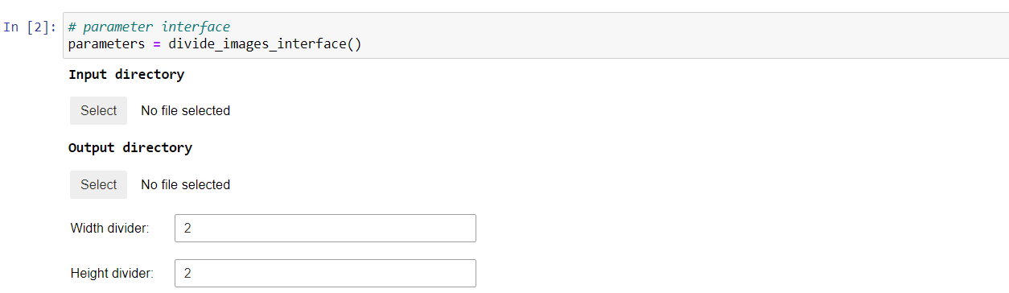
PreProcessing

Slide 3
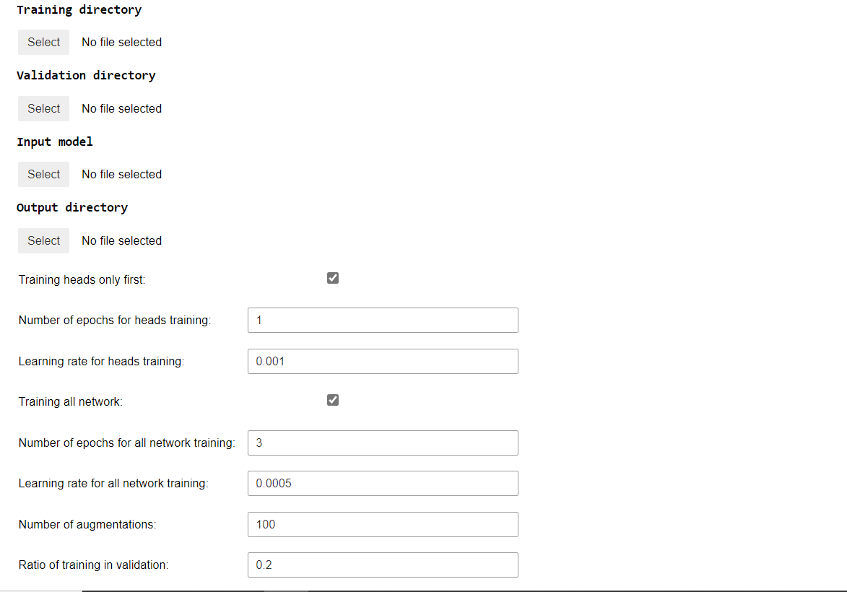
Training
Location of training dataset
If no validation directory is indicated, train_to_val_ratio of training dataset is randomly selected to define a validation dataset
Location of validation dataset
Input trained model used for transfer learning
Location of trained model
Training first network heads for fine tuning
Number of epochs for network heads training
Learning rate for network heads training
Training all network
Number of epochs for all network training
Learning rate for all network training
Number of augmented image for each image in the training dataset

Slide 4
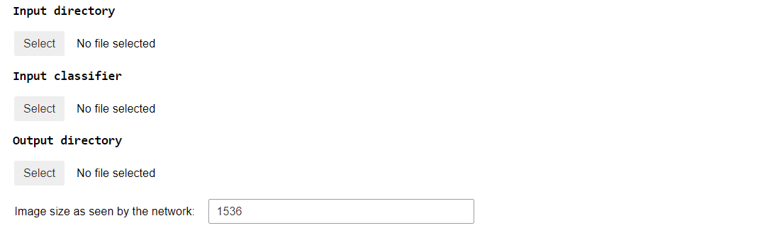
Running
Location of images to be processed
Location of trained classifier
Location for processed images
This acts as a scale selection:
The higher it is, the smaller the segmented objects are

Slide 5
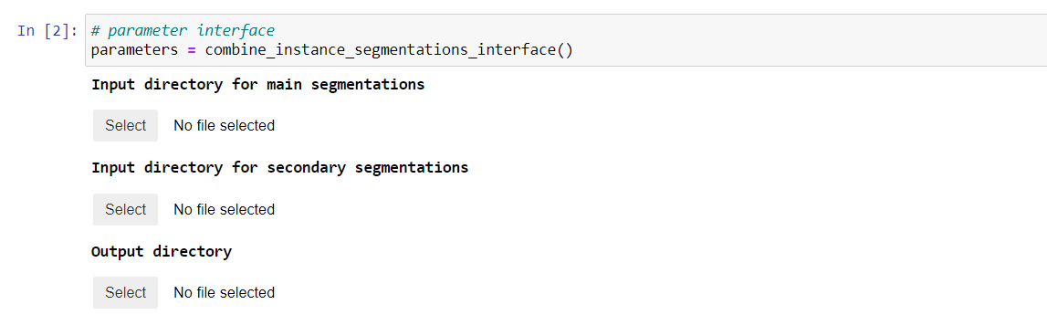
PostProcessing
Combine 2 instance segmentations

